Slide 1

Your Team Can Soar! Powerful Lessons to Help You Develop High Performance Teams
Wes Friesen
President: Solomon Training & Development; University Instructor, Speaker & Writer; Large Utility Manager (retired)

Slide 2
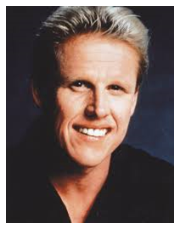
Developing High Performing Teams Can Wear You Out! BEFORE

Slide 3
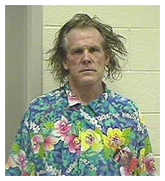
Developing High Performing Teams Can Wear You Out! AFTER

Slide 4
“Three Need Factors”
Equity (fairness)
  Physical Work Environment
  Economic
  Equity/Respect
Achievement
  Organization & Team
Camaraderie
  Interpersonally
  Teamwork

Slide 5
Six Things to Build Engagement
1) Don’t let newbies sink
2) Create a physically comfortable work environment
3) Eliminate perks that favor one level of employee over another
4) Avoid micromanaging
5) Spill the beans
6) Observe basic courtesies

Slide 6
Seven Things That Motivate People
1) Need for Achievement
2) Need for Power
3) Need for Affiliation
4) Need for Autonomy
5) Need for Esteem
6) Need for Safety and Security
7) Need for Equity

Slide 7
The Magical “5 to 1” Ratio
“Positive to Negative Comments”
Validated by:
Leadership team study
Psychologists Clifton & Rath
Dr. John Gottman

Slide 8
Dr. Gottman Study
One 15 minute conversation with 700 couples that were strangers to the Gottman research team.
The team predicted if ten years later couple would be divorced or married. Ten years later the team followed up, and they predicted with an accuracy rate of 94%!!
Basis for team’s prediction?
The magic five to one ratio!!

